Slide 1
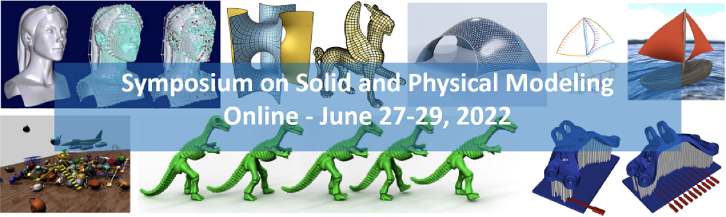



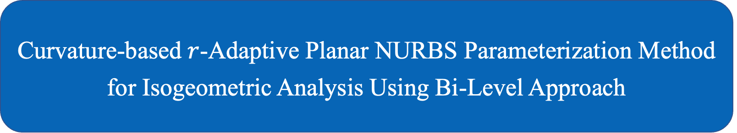
Introduction
Related work
Methodology
Results
Conclusions
Curvature-based $r$-Adaptive Planar NURBS Parameterization Method for Isogeometric Analysis Using Bi-Level Approach
Ye Ji, Meng-Yun Wang, Yu Wang, Chun-Gang Zhu*
﻿Institute of Computational Science, School of Mathematical Sciences
Dalian University of Technology, Dalian, China
﻿June 29, 2022
Dalian University of Technology, Ye Ji
June 29, 2022
﻿Curvature-based $r$-Adaptive Parameterization for IGA 1/33
Notes:
Hello, everyone. My name is Ye Ji, from Dalian University of Technology. I am glad to present our work: curvature-based r-adaptive planar NURBS parameterization method for isogeometric analysis using bi-level approach. This is a joint work with Mengyun Wang, Yu Wang, and my Ph.D. supervisor Chungang Zhu.

Slide 2
Introduction
Related work
Methodology
Results
Conclusions
Catalogue
Introduction
Related work
Methodology
Experimental results and comparisons
Conclusions and future work
Dalian University of Technology, Ye Ji
June 29, 2022
﻿Curvature-based $r$-Adaptive Parameterization for IGA 2/33

Slide 3
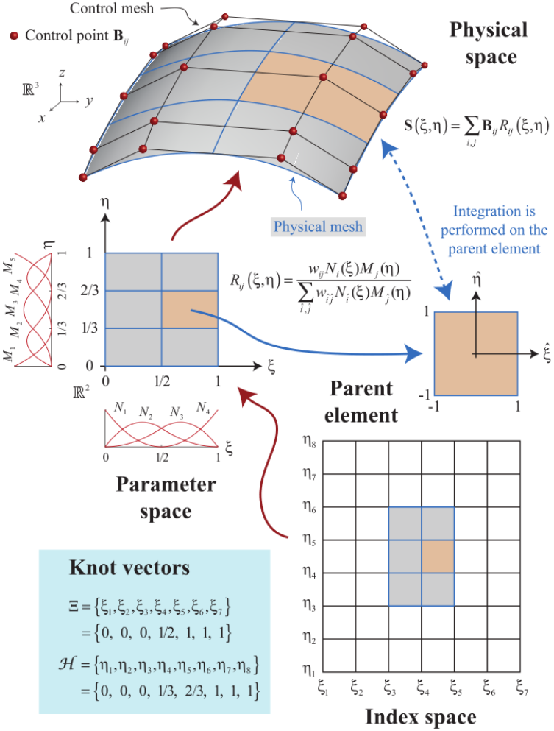
Introduction
Related work
Methodology
Results
Conclusions
IsoGeometric Analysis (IGA)
Proposed by T.J.R. Hughes et al., 2005.
KEY IDEA: ﻿approximate physical field with the same basis functions as that used to generate CAD models.
﻿Advantages:
Integration of design and analysis;
﻿Exact and efficient geometry;
﻿No data type transition and mesh generation;
﻿Simplified mesh refinement;
High order continuous field;
Superior approximation properties.
﻿Very broad applications: such as shell analysis, fluid-structure interaction, and structural shape and topology optimization.
Source: Figure from [Cottrell et al. 2009]
Dalian University of Technology, Ye Ji
June 29, 2022
﻿Curvature-based $r$-Adaptive Parameterization for IGA 3/33
Notes:
Isogeometric analysis was first proposed by Tom Hughes et al. in 2005. It is a well-known computational approach to integrate geometry modelling and numerical simulation. The exact and efficient geometry representation avoids the unnecessary data type transition. Therefore, IGA becomes a very appealing simulation technique both for the research and the engineering community.

Slide 4
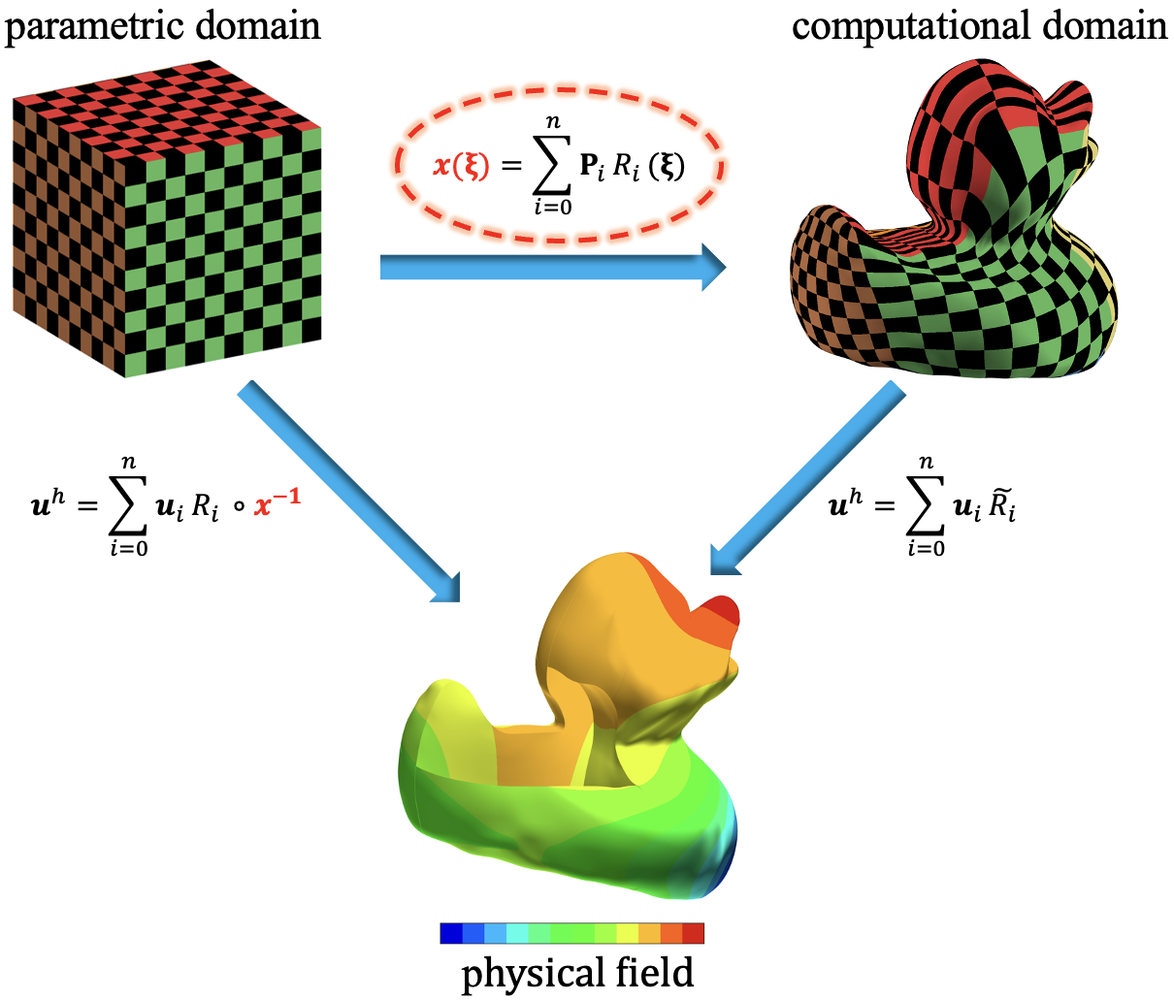
Introduction
Related work
Methodology
Results
Conclusions
Isotropic parameterization problem for IGA
Bijective parameterization construction is crucial
Similar to mesh generation in FEM;
Parameterization quality significantly affects the accuracy and efficiency of the analysis [Cohen et al. 2010, Xu et al. 2013, Pilgerstorfer and Jüttler 2013].
Isotropic parameterization:
Good orthogonality and uniformity;
Independent of the governing PDE and thus more efficient to generate.
Parameterization problem [Ji et al. 2022]
Dalian University of Technology, Ye Ji
June 29, 2022
﻿Curvature-based $r$-Adaptive Parameterization for IGA 4/33
Notes:
Similar to mesh generation in finite element method, constructing a bijective parameterization from the parametric domain to computational domain is a fundamental task in IGA. The parameterization quality significantly affects the accuracy and efficiency of the subsequent analysis.
Most previous works require parameterizations that have good orthogonality and uniformity in addition to bijectivity. One of its features is independent of the governing PDE. We call them isotropic parameterizations.

Slide 5
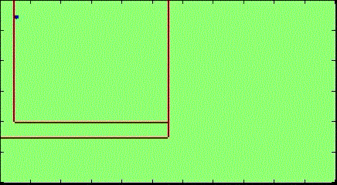
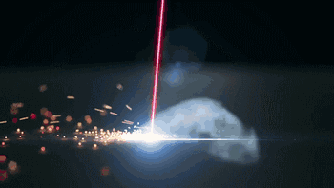
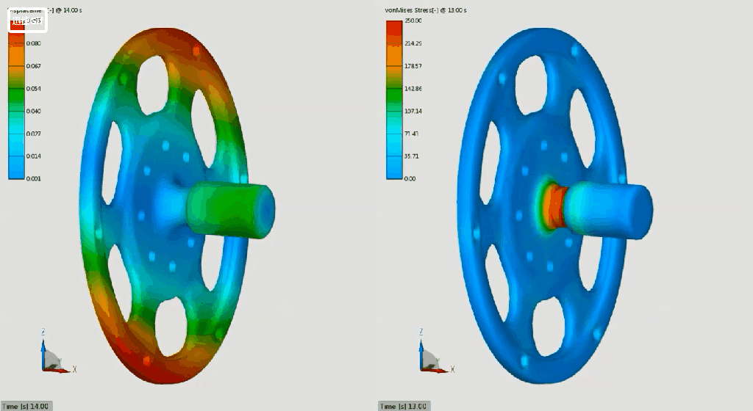
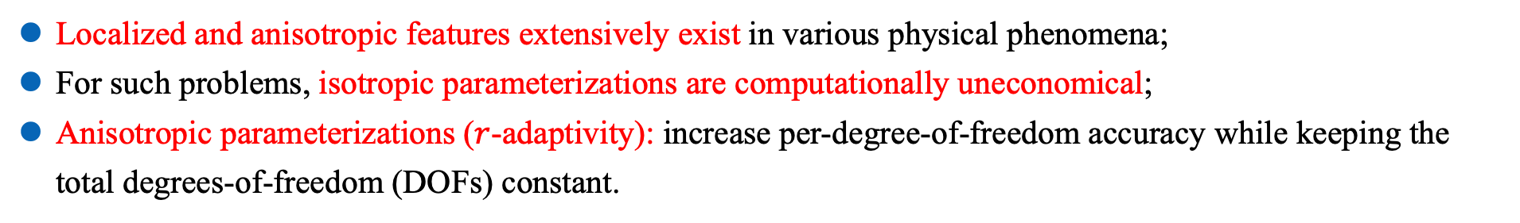
Introduction
Related work
Methodology
Results
Conclusions
Anisotropic phenomena in physics
Wave propagation. source [wiki/ Wave_propagation]
Laser printing. source
Stress concentration. source
Localized and anisotropic features extensively exist in various physical phenomena;
For such problems, isotropic parameterizations are computationally uneconomical;
Anisotropic parameterizations ($r$-adaptivity): increase per-degree-of-freedom accuracy while keeping the total degrees-of-freedom (DOFs) constant.
Dalian University of Technology, Ye Ji
June 29, 2022
﻿Curvature-based $r$-Adaptive Parameterization for IGA 5/33
Notes:
However, to a particular PDE, an isotropic parameterization may not be optimal in the sense of reducing numerical error. In Particular, local and anisotropic phenomena extensively exist, such as wave propagation, laser printing, and stress concentration. For such problems, isotropic parameterizations are computationally uneconomical.
To this end, we focus on anisotropic parameterizations in this work. That is, increase per-degree-of-freedom accuracy while keeping the total degrees-of-freedom constant.

Slide 6
Introduction
Related work
Methodology
Results
Conclusions
Our basic idea
Absolute principal curvature: to characterize the variations of the isogeometric solution;
A tight relationship between geometric quantity and isogeometric solution is established;
Absolute error and absolute principal curvature show similar performance (left figure);
Absolute principal curvature is a good error estimator.
Exact solution
IGA solution
Absolute error
Absolute principal curvature
Dalian University of Technology, Ye Ji
June 29, 2022
﻿Curvature-based $r$-Adaptive Parameterization for IGA 6/33
Notes:
In this work, our basic idea is regarding the isogeometric solution as a parametric surface in R3. And then, we use the absolute principal curvature to characterize the variations of the solution. Therefore, it establishes a tight relationship between the geometric quantity and isogeometric solution.
As shown in the left figures, the absolute error and the absolute principle curvature show a similar performance. In the regions where the solution varies greatly, the error is also relatively large. In the meantime, the absolute principle curvature is large. Therefore, the principal curvature would be a good error estimator.

Slide 7
Introduction
Related work
Methodology
Results
Conclusions
Our basic idea - cont'd
Anisotropic parameterizations are often solution-dependent:
Need good numerical solution accuracy to drive parameterization;
Adjust as few control points as possible for high efficiency;
Bi-level strategy: a coarse level (design model) to update the parameterization for efficiency’s sake and a fine level (analysis model) to perform the isogeometric simulation for accuracy’s sake.
Dalian University of Technology, Ye Ji
June 29, 2022
﻿Curvature-based $r$-Adaptive Parameterization for IGA 7/33
Notes:
Compared with isotropic parameterizations, anisotropic parameterizations are often solution-dependent. That is to say, the governing PDE is solved continually during iterations. On the one hand, the accuracy of the isogeometric solution is very important, and thus we need more degrees-of-freedom to solve the PDE. On the other hand, too many degrees-of-freedom affects the efficiency greatly. Inspired by isogeometric shape optimization, a bi-level strategy is adopted here. We separate the models into design model and analysis model to balance the efficiency and accuracy.
More precisely, a coarse level is used to update the parameterization for efficiency’s sake, and a fine level is used to perform analysis for accuracy’s sake.

Slide 8
Introduction
Related work
Methodology
Results
Conclusions
Catalogue
Introduction
Related work
Methodology
Experimental results and comparisons
Conclusions and future work
Dalian University of Technology, Ye Ji
June 29, 2022
﻿Curvature-based $r$-Adaptive Parameterization for IGA 8/33

Slide 9
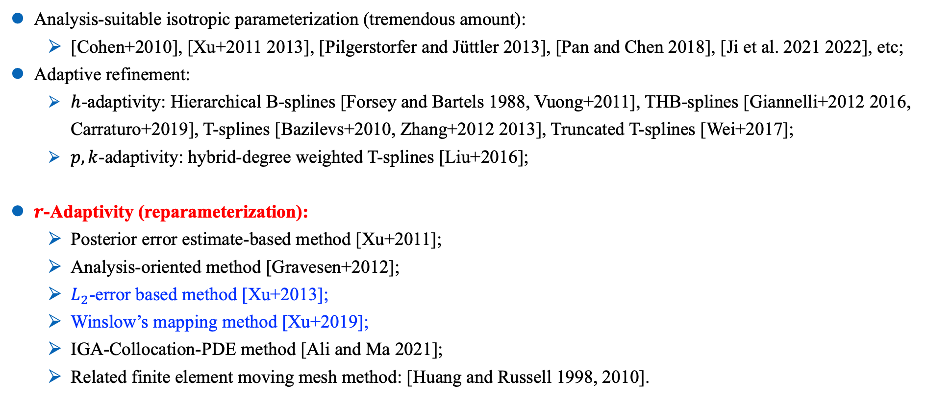
Introduction
Related work
Methodology
Results
Conclusions
Related work
Analysis-suitable isotropic parameterization (tremendous amount):
[Cohen+2010], [Xu+2011 2013], [Pilgerstorfer and Jüttler 2013], [Pan and Chen 2018], [Ji et al. 2021 2022], etc;
Adaptive refinement:
$h$-adaptivity: Hierarchical B-splines [Forsey and Bartels 1988, Vuong+2011], THB-splines [Giannelli+2012 2016, Carraturo+2019], T-splines [Bazilevs+2010, Zhang+2012 2013], Truncated T-splines [Wei+2017];
$p,k$-adaptivity: hybrid-degree weighted T-splines [Liu+2016];
$r$-Adaptivity (reparameterization):
Posterior error estimate-based method [Xu+2011];
Analysis-oriented method [Gravesen+2012];
$L_{2}$-error based method [Xu+2013];
Winslow’s mapping method [Xu+2019];
IGA-Collocation-PDE method [Ali and Ma 2021];
Related finite element moving mesh method: [Huang and Russell 1998, 2010].
Dalian University of Technology, Ye Ji
June 29, 2022
﻿Curvature-based $r$-Adaptive Parameterization for IGA 9/33
Notes:
Since constructing analysis-suitable parameterizations is a fundamental task in IGA, new theories and methods have constantly emerged. Many works develop various methods to construct analysis-suitable isotropic parameterization.
To anisotropic parameterizations, many previous works focus on adaptive refinement using the spline tools with the capacity of local refinements, such as THB-splines and T-splines. These methods try to increase degrees-of-freedom in regions with large numerical errors and show remarkable performance in local problems.
Another possible solution is r-adaptivity based on reparameterization. As far as we know, in the context of IGA, this kind of method dates back to the r-refinement method proposed by Xu et al. in 2011. In contrast to h-adaptivity, r-adaptive methods increase per-degree-of-freedom accuracy while keeping the total degrees-of-freedom constant. In this work, we aim at developing an efficient and robust r-adaptive parameterization technique.

Slide 10
Introduction
Related work
Methodology
Results
Conclusions
Catalogue
Introduction
Related work
Methodology
Experimental results and comparisons
Conclusions and future work
Dalian University of Technology, Ye Ji
June 29, 2022
﻿Curvature-based $r$-Adaptive Parameterization for IGA 10/33

Slide 11
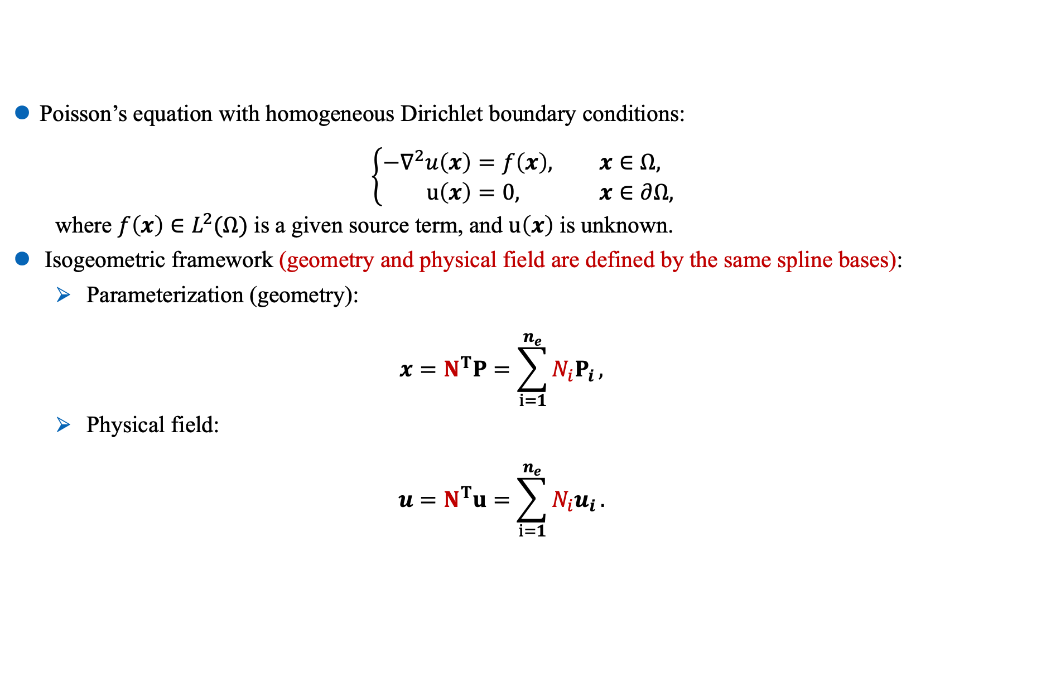
Introduction
Related work
Methodology
Results
Conclusions
Model problem: Poisson’s equation
Poisson’s equation with homogeneous Dirichlet boundary conditions:
$$\left\{\begin{aligned}−∇^{2}u\left(x\right)&=f\left(x\right), &&x∈Ω, \\ u\left(x\right)&=0, &&x∈∂Ω,\end{aligned}\right.$$
where $f\left(x\right)∈L^{2}(Ω)$ is a given source term, and $u\left(x\right)$ is unknown.
Isogeometric framework (geometry and physical field are defined by the same spline bases):
Parameterization (geometry):
$$x=N^{T}P=\sum_{i=1}^{n_{e}}{N_{i}P_{i}},$$
Physical field:
$$u=N^{T}u=\sum_{i=1}^{n_{e}}{N_{i}u_{i}}.$$
Dalian University of Technology, Ye Ji
June 29, 2022
﻿Curvature-based $r$-Adaptive Parameterization for IGA 11/33
Notes:
We consider Poisson’s equation as a model problem.
Our adaptivity method is related to the governing PDE. However, we emphasize that the proposed method is applicable to other PDEs almost seamlessly.
In the IGA framework, the geometry and the physical field are defined by the same spline-based basis functions. In this work, we use the standard NURBS basis functions which is the most popular choice.

Slide 12
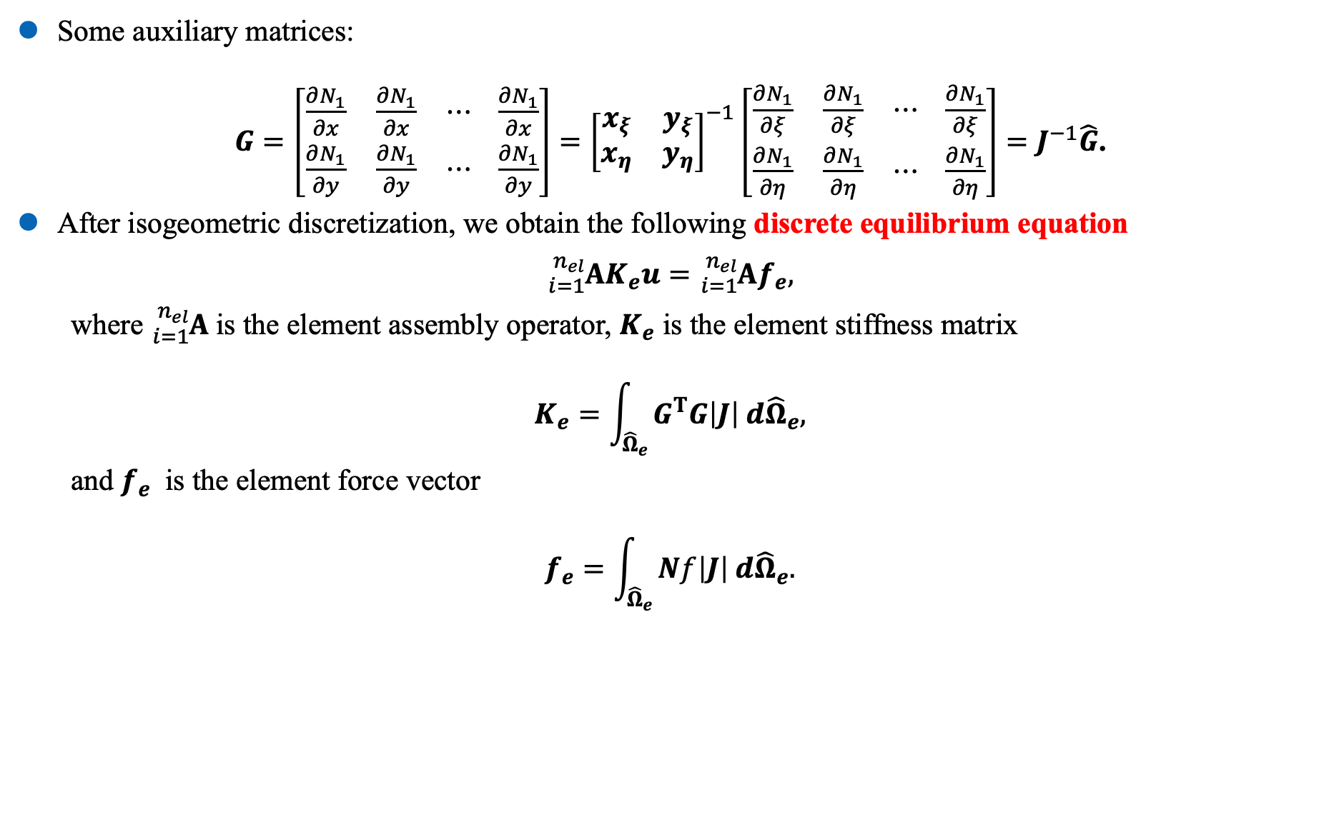
Introduction
Related work
Methodology
Results
Conclusions
Model problem: notations
Some auxiliary matrices:
$G=\left[\begin{matrix}\frac{∂N_{1}}{∂x} & \frac{∂N_{1}}{∂x} & ⋯ \\ \frac{∂N_{1}}{∂y} & \frac{∂N_{1}}{∂y} & ⋯ \end{matrix}\begin{matrix} \frac{∂N_{1}}{∂x} \\ \frac{∂N_{1}}{∂y}\end{matrix}\right]={\left[\begin{matrix}x_{ξ} & y_{ξ} \\ x_{η} & y_{η}\end{matrix}\right]}^{−1}\left[\begin{matrix}\frac{∂N_{1}}{∂ξ} & \frac{∂N_{1}}{∂ξ} & ⋯ \\ \frac{∂N_{1}}{∂η} & \frac{∂N_{1}}{∂η} & ⋯ \end{matrix}\begin{matrix} \frac{∂N_{1}}{∂ξ} \\ \frac{∂N_{1}}{∂η}\end{matrix}\right]=J^{−1}\hat{G}$.
After isogeometric discretization, we obtain the following discrete equilibrium equation
$${}_{i=1}^{n_{el}}{AK_{e}}u={}_{i=1}^{n_{el}}{Af_{e}},$$
where ${}_{i=1}^{n_{el}}A$is the element assembly operator, $K_{e}$ is the element stiffness matrix
$$K_{e}=\int_{{\hat{Ω}}_{e}}{G^{T}G\left|J\right| d{\hat{Ω}}_{e},}$$
and $f_{e}$ is the element force vector
$$f_{e}=\int_{{\hat{Ω}}_{e}}{Nf\left|J\right| d{\hat{Ω}}_{e}.}$$
Dalian University of Technology, Ye Ji
June 29, 2022
﻿Curvature-based $r$-Adaptive Parameterization for IGA 12/33
Notes:
Next, we define some auxiliary matrices. G and the hat G denote the matrix formed by the derivatives of basis functions with respect to the physical coordinate and the parameter coordinate, respectively.
After isogeometric discretization, we have the following discrete equilibrium equation. Here, the operator A is the standard element assembly operator in IGA.

Slide 13
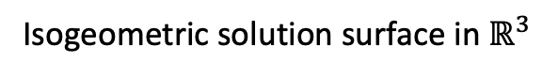
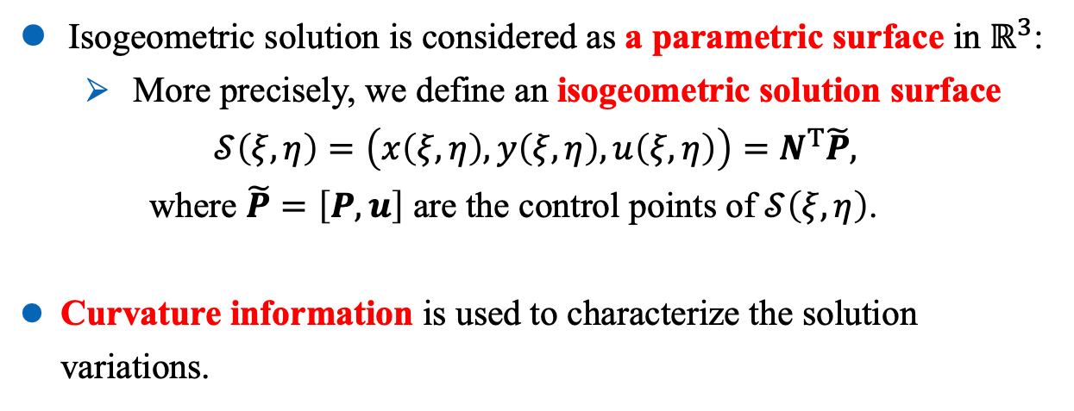
Introduction
Related work
Methodology
Results
Conclusions
Isogeometric solution surface
Isogeometric solution is considered as a parametric surface in $ℝ^{3}$:
More precisely, we define an isogeometric solution surface
$$𝒮\left(ξ,η\right)=\left(x\left(ξ,η\right),y\left(ξ,η\right), u\left(ξ,η\right)\right)=N^{T}\tilde{P},$$
where $\tilde{P}=\left[P, u\right]$ are the control points of $𝒮\left(ξ,η\right)$.
Curvature information is used to characterize the solution variations.
Isogeometric solution surface in $ℝ^{3}$
Dalian University of Technology, Ye Ji
June 29, 2022
﻿Curvature-based $r$-Adaptive Parameterization for IGA 13/33
Notes:
Then we set the isogeometric solution u as the third component of the geometry. The isogeometric solution surface is shown in the right figure.
And then its curvature can be used to characterize the variations of the solution.

Slide 14
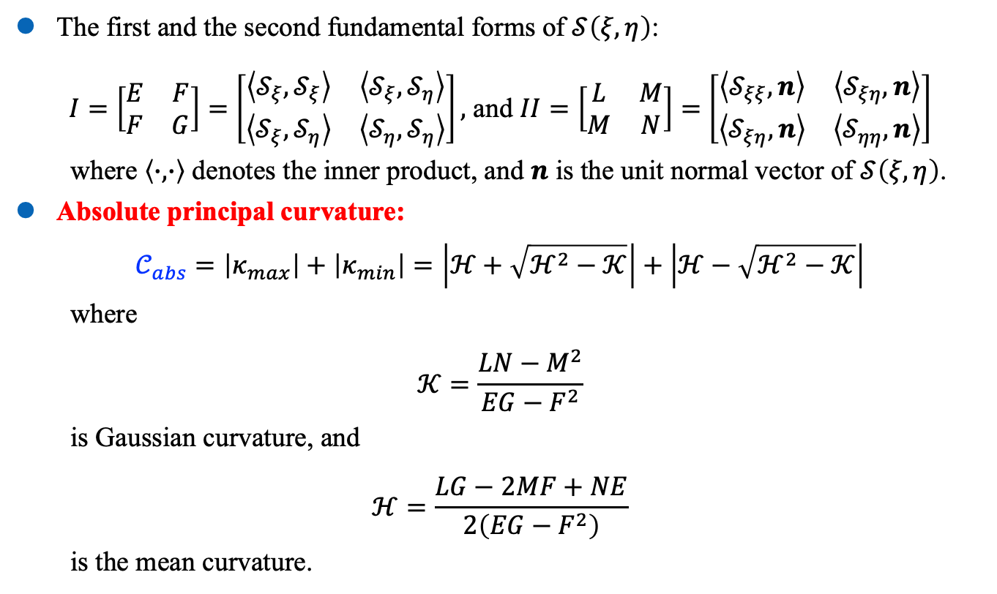
Introduction
Related work
Methodology
Results
Conclusions
Absolute principal curvature
The first and the second fundamental forms of $𝒮\left(ξ,η\right)$:
$I=\left[\begin{matrix}E & F \\ F & G\end{matrix}\right]=$ $\left[\begin{matrix}\left\langle 𝒮_{ξ},𝒮_{ξ}\right\rangle & \left\langle 𝒮_{ξ},𝒮_{η}\right\rangle \\ \left\langle 𝒮_{ξ},𝒮_{η}\right\rangle & \left\langle 𝒮_{η},𝒮_{η}\right\rangle \end{matrix}\right],$ and $II=\left[\begin{matrix}L & M \\ M & N\end{matrix}\right]=$ $\left[\begin{matrix}\left\langle 𝒮_{ξξ},n\right\rangle & \left\langle 𝒮_{ξη}, n\right\rangle \\ \left\langle 𝒮_{ξη},n\right\rangle & \left\langle 𝒮_{ηη},n\right\rangle \end{matrix}\right]$
where $\left\langle ∙, ∙\right\rangle$ denotes the inner product, and $n$ is the unit normal vector of $𝒮\left(ξ,η\right)$.
Absolute principal curvature:
$$𝒞_{abs}=\left|κ_{max}\right|+\left|κ_{min}\right|=\left|ℋ+\sqrt{ℋ^{2}−𝒦}\right|+\left|ℋ−\sqrt{ℋ^{2}−𝒦}\right|$$
where
$$𝒦=\frac{LN−M^{2}}{EG−F^{2}}$$
is Gaussian curvature, and
$$ℋ=\frac{LG−2MF+NE}{2\left(EG−F^{2}\right)}$$
is the mean curvature.
Isogeometric solution surface
Absolute principal curvature
Dalian University of Technology, Ye Ji
June 29, 2022
﻿Curvature-based $r$-Adaptive Parameterization for IGA 14/33
Notes:
Now, we introduce the first and the second fundamental forms of the surface. Then the absolute principal curvature can be defined by the absolute value summation of the maximum and the minimum principal curvatures. Here, K is the Gaussian curvature and H is the mean curvature.
The colormap of absolute principal curvature is shown in the right figure. It can be seen that the regions with large variations cause a large absolute principal curvature. Therefore, we use it to detect the regions with large numerical error.

Slide 15
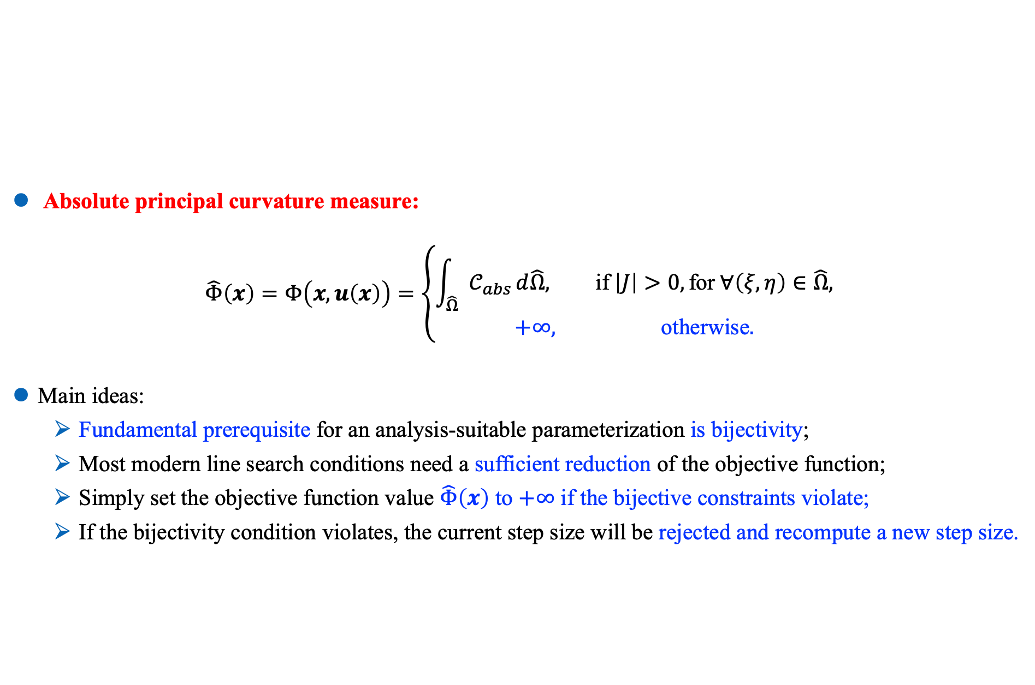
Introduction
Related work
Methodology
Results
Conclusions
Objective function
Absolute principal curvature measure:
$$\hat{Φ}\left(x\right)=Φ\left(x,u\left(x\right)\right)=\left\{\begin{matrix}\int_{\hat{Ω}}{𝒞_{abs}}d\hat{Ω}, \text{if} \left|J\right|>0, \text{for} ∀\left(ξ,η\right)∈\hat{Ω}, \\ +∞, \text{otherwise}.\end{matrix}\right.$$
Main ideas:
Fundamental prerequisite for an analysis-suitable parameterization is bijectivity;
Most modern line search conditions need a sufficient reduction of the objective function;
Simply set the objective function value $\hat{Φ}\left(x\right)$ to $+∞$ if the bijective constraints violate;
If the bijectivity condition violates, the current step size will be rejected and recompute a new step size.
Dalian University of Technology, Ye Ji
June 29, 2022
﻿Curvature-based $r$-Adaptive Parameterization for IGA 15/33
Notes:
With the pointwise absolute principal curvature in hand, we define the following objective function.
It is well-known that a fundamental prerequisite for an analysis-suitable parameterization is bijectivity. Most modern first-order optimization solvers are equipped with a line search criterion to ensure sufficient reduction of the objective function. Taking advantage of this feature, we simply set the objective function to positive infinity if the bijective constraints violate. Intuitively speaking, if the bijectivity condition violates, the optimization solver will reject the current step size and recompute a new step size.

Slide 16
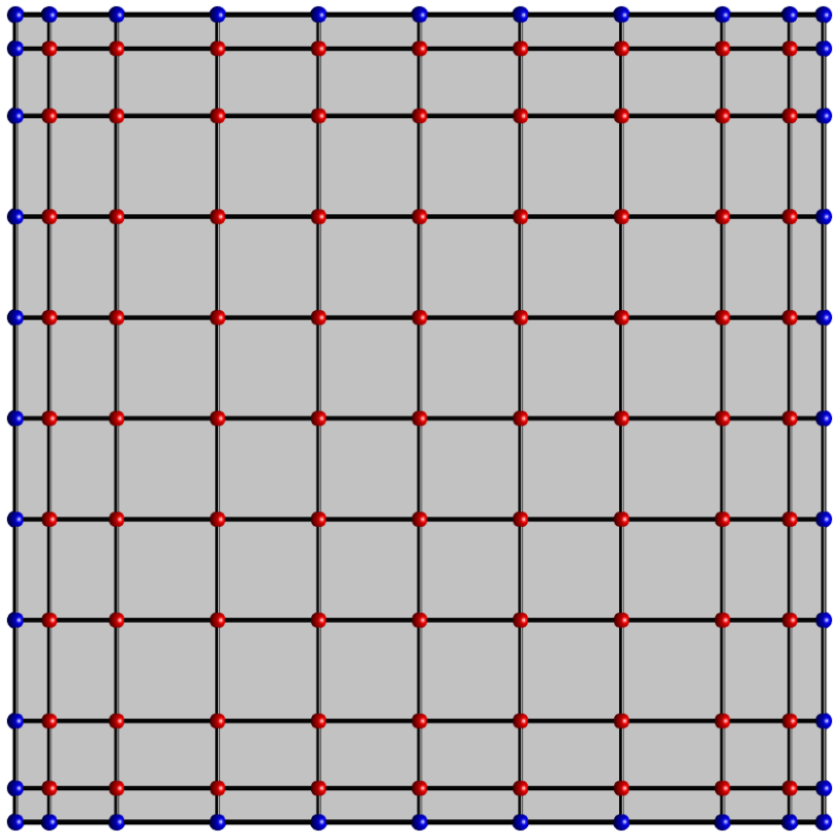
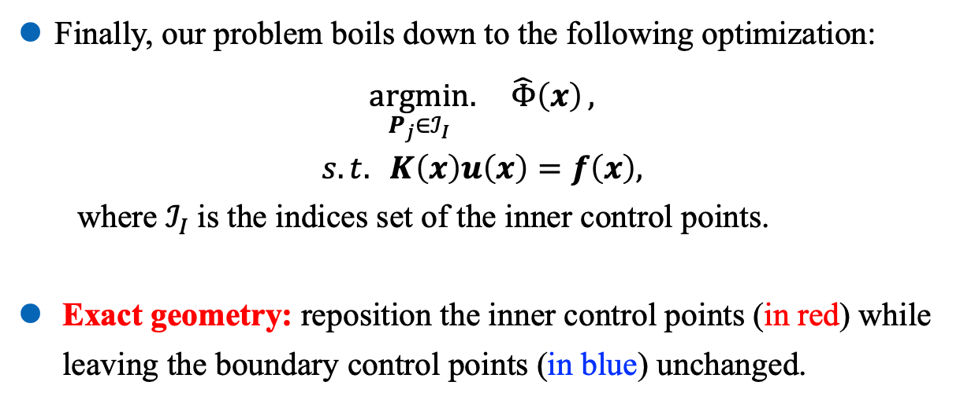
Introduction
Related work
Methodology
Results
Conclusions
Objective function
moveable inner control points
Finally, our problem boils down to the following optimization:
$$\underset{P_{j}∈ℐ_{I}}{argmin}{. \hat{Φ}\left(x\right)},$$
$$s.t. K\left(x\right)u\left(x\right)=f\left(x\right),$$
where $ℐ_{I}$is the indices set of the inner control points.
Exact geometry: reposition the inner control points (in red) while leaving the boundary control points (in blue) unchanged.
fixed boundary control points
Dalian University of Technology, Ye Ji
June 29, 2022
﻿Curvature-based $r$-Adaptive Parameterization for IGA 16/33
Notes:
By taking the coordinates of the inner control points as optimization variables, our curvature-based r-adaptive problem boils down to the following non-linear optimization problem. In addition, we reposition the inner control points while leaving the boundary control points unchanged, and thus the exact geometry of the computational domain remains.

Slide 17
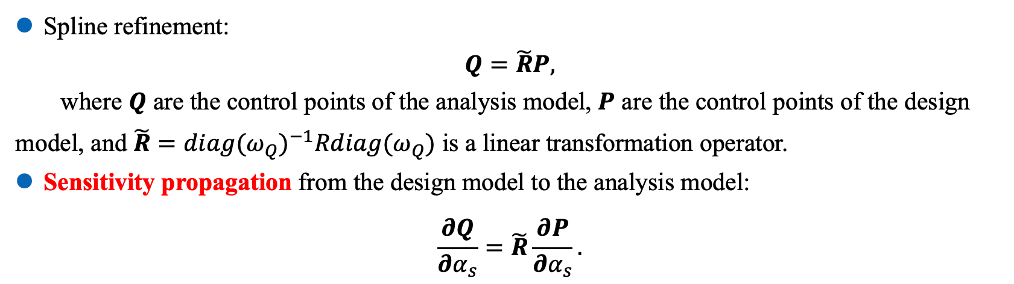
Introduction
Related work
Methodology
Results
Conclusions
Sensitivity analysis - Sensitivity propagation from design model to analysis model
Spline refinement:
$$Q=\tilde{R}P,$$
where $Q$ are the control points of the analysis model, $P$ are the control points of the design model, and $\tilde{R}={diag(ω_{Q})}^{−1}Rdiag(ω_{Q})$ is a linear transformation operator.
Sensitivity propagation from the design model to the analysis model:
$$\frac{∂Q}{∂α_{s}}=\tilde{R}\frac{∂P}{∂α_{s}}.$$
Sensitivity Propagation
Dalian University of Technology, Ye Ji
June 29, 2022
﻿Curvature-based $r$-Adaptive Parameterization for IGA 17/33
Notes:
During the optimization process, an analytical gradient is very important to efficiency and stability. Therefore, we next explain how to perform analytical sensitivity.
Since a coarse design model and a fine analysis model is used in our method, we need to perform the sensitivity propagation from the design model to the analysis model. First of all, the control points of the analysis model is obtained by the control points of the design model through a linear transformation. Here, we denote the linear transformation operator by R tilde. Then the sensitivity can propagate to the analysis model by using the linear transformation operator again.

Slide 18
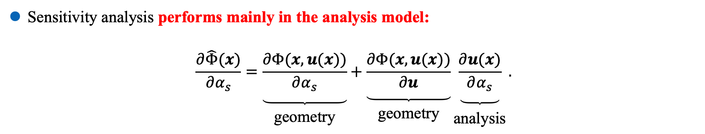
Introduction
Related work
Methodology
Results
Conclusions
Sensitivity analysis in the analysis model
Sensitivity analysis performs mainly in the analysis model:
$$\frac{∂\hat{Φ}(x)}{∂α_{s}}=\underset{\begin{aligned} \\ \text{geometry}\end{aligned}}{\underbrace{\frac{∂Φ(x,u(x))}{∂α_{s}}}}+\underset{\begin{aligned} \\ \text{geometry}\end{aligned}}{\underbrace{\frac{∂Φ(x,u(x))}{∂u}}}\underset{\begin{aligned} \\ \text{analysis}\end{aligned}}{\underbrace{\frac{∂u(x)}{∂α_{s}}}}.$$
Sensitivity Analysis
Dalian University of Technology, Ye Ji
June 29, 2022
﻿Curvature-based $r$-Adaptive Parameterization for IGA 18/33
Notes:
Once the sensitivity propagation is done, the subsequent sensitivity analysis will be performed mainly in the analysis model. We separate the sensitivity of the objective function into two parts: the geometry part and the analysis part.

Slide 19
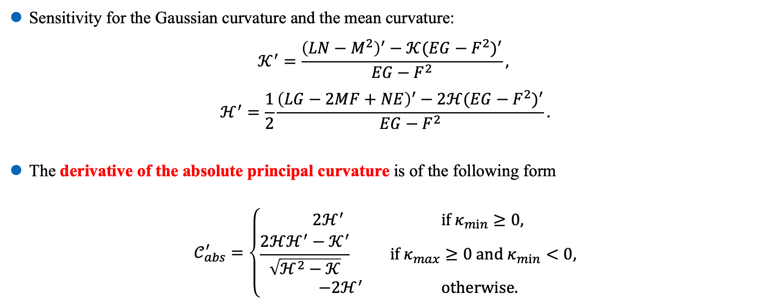
Introduction
Related work
Methodology
Results
Conclusions
Sensitivity analysis – geometry part
Sensitivity for the Gaussian curvature and the mean curvature:
$$𝒦^{′}=\frac{{\left(LN−M^{2}\right)}^{′}−𝒦{(EG−F^{2})}^{′}}{EG−F^{2}},$$
$$ℋ^{′}=\frac{1}{2}\frac{{\left(LG−2MF+NE\right)}^{′}−2ℋ{(EG−F^{2})}^{′}}{EG−F^{2}}.$$
The derivative of the absolute principal curvature is of the following form
$$𝒞_{abs}^{′}=\left\{\begin{matrix}2ℋ^{′} if κ_{min}≥0, \\ \frac{2ℋℋ^{′}−𝒦^{′}}{\sqrt{ℋ^{2}−𝒦}} if κ_{max}≥0 and{ κ}_{min}<0, \\ −2ℋ^{′} \text{otherwise}.\end{matrix}\right.$$
Dalian University of Technology, Ye Ji
June 29, 2022
﻿Curvature-based $r$-Adaptive Parameterization for IGA 19/33
Notes:
Now, we fucus on the geometry part. After some basic computation of the derivatives, we obtain the sensitivity for the Gaussian curvature and the mean curvature. By inserting these formulas into the derivatives of the absolute principal curvature, we obtain its sensitivity of the following form.

Slide 20
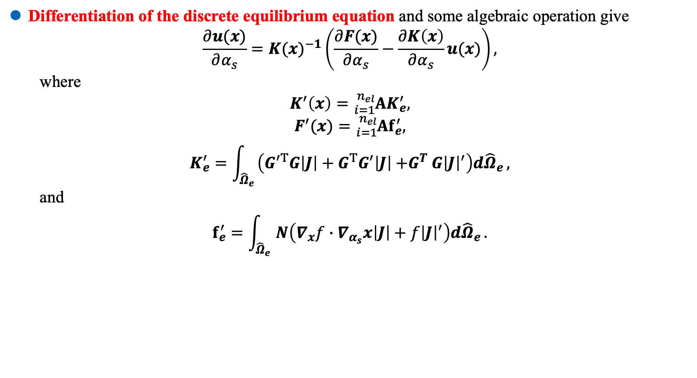
Introduction
Related work
Methodology
Results
Conclusions
Sensitivity analysis – analysis part
Differentiation of the discrete equilibrium equation and some algebraic operation give
$$\frac{∂u(x)}{∂α_{s}}={K(x)}^{−1}\left(\frac{∂F(x)}{∂α_{s}}−\frac{∂K\left(x\right)}{∂α_{s}}u(x)\right),$$
where
$$K^{′}\left(x\right)={}_{i=1}^{n_{el}}{AK_{e}^{′}},$$
$$F^{′}(x)={}_{i=1}^{n_{el}}{Af_{e}^{′},}$$
$$K_{e}^{′}=\int_{{\hat{Ω}}_{e}}{\left(G^{′T}G\left|J\right|+G^{T}G^{′}\left|J\right|{+G}^{T}G{\left|J\right|}^{′}\right)d{\hat{Ω}}_{e}},$$
and
$$f_{e}^{′}=\int_{{\hat{Ω}}_{e}}{N\left(∇_{x}f∙∇_{α_{s}}x\left|J\right|+f{\left|J\right|}^{′}\right)d{\hat{Ω}}_{e}}.$$
Dalian University of Technology, Ye Ji
June 29, 2022
﻿Curvature-based $r$-Adaptive Parameterization for IGA 20/33
Notes:
The analysis part is related to the discrete equilibrium equation. By differentiation and some computation, we obtain the sensitivity of u. Here, the derivatives of the stiffness matrix K and the load vector f are obtained by assembling the derivatives of their element counterpart.

Slide 21
Introduction
Related work
Methodology
Results
Conclusions
Catalogue
Introduction
Related work
Methodology
Experimental results and comparisons
Conclusions and future work
Dalian University of Technology, Ye Ji
June 29, 2022
﻿Curvature-based $r$-Adaptive Parameterization for IGA 21/33

Slide 22
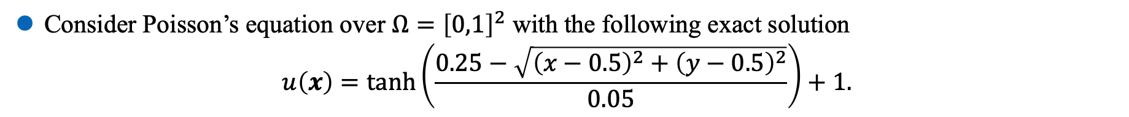
Introduction
Related work
Methodology
Results
Conclusions
Toy problem: the square case
Consider Poisson’s equation over $Ω={\left[0,1\right]}^{2}$ with the following exact solution
$$u\left(x\right)=\tanh\left(\frac{0.25−\sqrt{{\left(x−0.5\right)}^{2}+{\left(y−0.5\right)}^{2}}}{0.05}\right)+1.$$
Dalian University of Technology, Ye Ji
June 29, 2022
﻿Curvature-based $r$-Adaptive Parameterization for IGA 22/33
Notes:
In the first example, we consider a Poisson’s equation over a squared computational domain. A bi-linear B-spline representation is sufficient to represent a square. However, there is no flexibility to adjust the parameterization. To this end, we perform several refinements to obtain the design model. The design model has 11 × 11 control points, and then the inner 9 × 9 control points are set as optimization variables. Then the analysis models are obtained by h-refinement or p-refinement to ensure sufficient analysis accuracy. The exact solution is shown in the right figure.

Slide 23
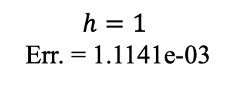
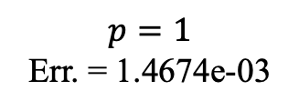
Introduction
Related work
Methodology
Results
Conclusions
Toy problem: the square case – cont’d
Initial (isotropic)
Err. = 1.2093e-02
No refinment
Err. = 4.4468e-03
$$p=1$$
Err. = 1.4674e-03
$$h=1$$
Err. = 1.1141e-03
Dalian University of Technology, Ye Ji
June 29, 2022
﻿Curvature-based $r$-Adaptive Parameterization for IGA 23/33
Notes:
The left two figures show the initial isotropic parameterization and its corresponding error colormap. And the results with different refinement levels are also given.
We can see that the resulting inner control points move towards the regions with large numerical errors. Compared with the isotropic parameterization, the proposed method dramatically reduce the numerical error. With the increase of refinement levels, more satisfactory numerical results are obtained. The reason is that a more accurate analysis result offers better guidance of adaptive parameterization. It demonstrates the effectiveness of our bi-level approach.

Slide 24
Introduction
Related work
Methodology
Results
Conclusions
Toy problem: the square case – cont’d
High numerical accuracy remains in finer meshes;
Our method shows better performance than the original Winslow method [Xu et al. 2019].
Dalian University of Technology, Ye Ji
June 29, 2022
﻿Curvature-based $r$-Adaptive Parameterization for IGA 24/33
Notes:
This figure shows the error history during h-refinement. Since the parameterization remains unchanged during the refinement process, the high numerical accuracy remains in fine meshes. It means that if an r-adaptive parameterization is obtained at a coarse level, the high accuracy may hold in the fine levels.

Slide 25
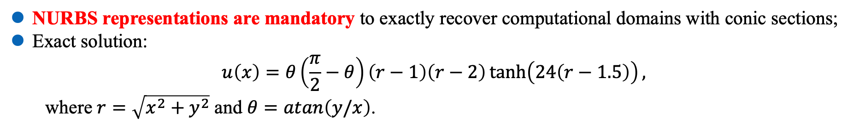
Introduction
Related work
Methodology
Results
Conclusions
NURBS geometry: quarter annulus
NURBS representations are mandatory to exactly recover computational domains with conic sections;
Exact solution:
$$u\left(x\right)=θ\left(\frac{π}{2}−θ\right)\left(r−1\right)\left(r−2\right)\tanh\left(24\left(r−1.5\right)\right),$$
where $r=\sqrt{x^{2}+y^{2}}$ and $θ=atan\left(y/x\right)$.
Dalian University of Technology, Ye Ji
June 29, 2022
﻿Curvature-based $r$-Adaptive Parameterization for IGA 25/33
Notes:
A B-spline representation is sufficient for a square. However, NURBS representations are mandatory to exactly recover conic sections, such as ellipses. In this example, we consider Poisson’s equation over a quarter annulus.

Slide 26
Introduction
Related work
Methodology
Results
Conclusions
Design model
Ours, no Refinement
Err.=2.0980e-03
L2 error [Xu et al. 2013] Err.=5.5329e-04
Initial (isotropic)
Err.=4.3519e-03
Ours, h=1
Err.=1.2247e-03
Winslow [Xu et al. 2019] Err.=1.7134e-03
Dalian University of Technology, Ye Ji
June 29, 2022
﻿Curvature-based $r$-Adaptive Parameterization for IGA 26/33
Notes:
The colormaps of numerical errors obtained by different methods are given. Compared with the initial parameterization, all the r-adaptivity methods reduce the numerical errors dramatically. The figures in the second column reveal that higher numerical accuracy is achieved thanks to the bi-level approach.
Although L2 error-based method outperforms the other two methods, this method needs a known exact solution. However, the exact solution is unknown for most practical applications.

Slide 27
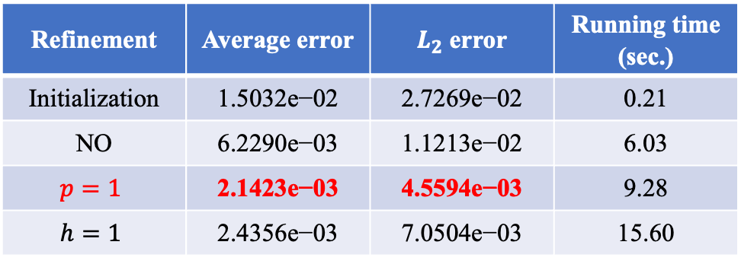
Introduction
Related work
Methodology
Results
Conclusions
More complicated geometry
Initial parameterization [Ji et al. 2021]
Exact solution
Refinement | Average error | $L_{2}$ error | Running time (sec.)
Initialization | 1.5032e−02 | 2.7269e−02 | 0.21
NO | 6.2290e−03 | 1.1213e−02 | 6.03
$$p=1$$ | 2.1423e−03 | 4.5594e−03 | 9.28
$$h=1$$ | 2.4356e−03 | 7.0504e−03 | 15.60
Dalian University of Technology, Ye Ji
June 29, 2022
﻿Curvature-based $r$-Adaptive Parameterization for IGA 27/33
Notes:
Next, we further consider a more complicated geometry. The initial isotropic parameterization and the corresponding exact solution are shown.
As shown in the table, our method effectively reduces the computational error. Furthermore, more satisfying results are obtained by using the proposed bi-level technique. In this example, p-refinement shows the best performance.

Slide 28
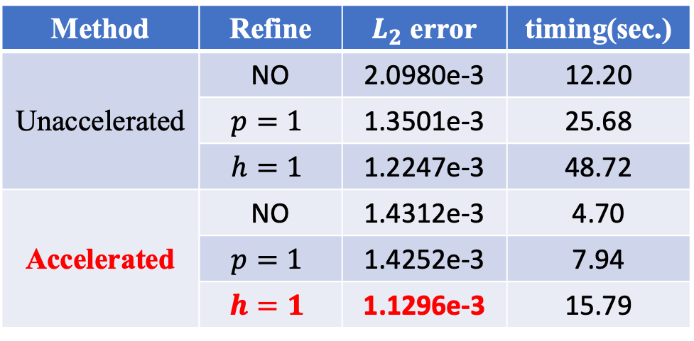
Introduction
Related work
Methodology
Results
Conclusions
Acceleration strategy
Setting all the inner control points as optimization variables is computationally uneconomical;
We compute the sensitivity once before iteration and select the ones with large derivatives.
Method | Refine | $L_{2}$ error | timing(sec.)
Unaccelerated | NO | 2.0980e-3 | 12.20
unaccelerated | $$p=1$$ | 1.3501e-3 | 25.68
 | $$h=1$$ | 1.2247e-3 | 48.72
Accelerated | NO | 1.4312e-3 | 4.70
accelerated | $$p=1$$ | 1.4252e-3 | 7.94
 | $$h=1$$ | 1.1296e-3 | 15.79
Dalian University of Technology, Ye Ji
June 29, 2022
﻿Curvature-based $r$-Adaptive Parameterization for IGA 28/33
Notes:
Sometimes, setting all the inner control points as optimization variables is computationally uneconomical. The control points away from the features have a very limited influence on the results and nearly remain stationary. Based on this observation, we give a simple acceleration strategy.
We compute the sensitivity to all inner control points once before iteration. Then we set the ones with large norm values of the derivatives as optimization variables. As shown in the left figure, 24 control points in red are set as optimization variables. Surprisingly, better performance than the unaccelerated case is observed in this example. Most importantly, this strategy gains significant accelerations of over 50%.

Slide 29
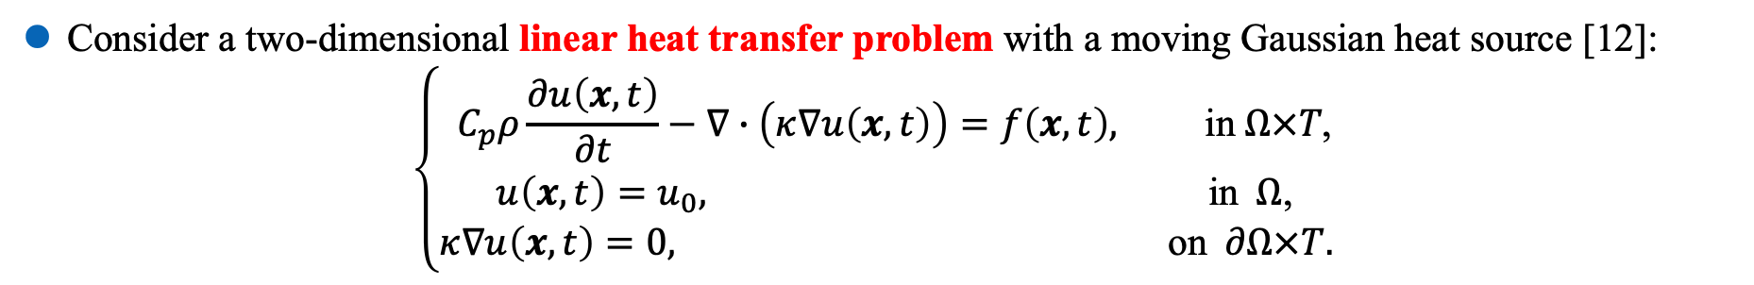
Introduction
Related work
Methodology
Results
Conclusions
Application: Time-dependent dynamic PDE
Consider a two-dimensional linear heat transfer problem with a moving Gaussian heat source [12]:
$$\left\{\begin{matrix}C_{p}ρ\frac{∂u\left(x,t\right)}{∂t}−∇∙\left(κ∇u\left(x,t\right)\right)=f\left(x,t\right), \text{in} Ω×T\text{,} \\ u\left(x,t\right)=u_{0}, \text{in} Ω\text{,} \\ κ∇u\left(x,t\right)=0, \text{on} ∂Ω×T. \end{matrix}\right.$$
Dalian University of Technology, Ye Ji
June 29, 2022
﻿Curvature-based $r$-Adaptive Parameterization for IGA 29/33
Notes:
To demonstrate the capability of the proposed method, we consider a two-dimensional linear heat transfer problem. More precisely, we consider the following initial-boundary value problem. The scan track of the heat source and the parameters are shown in the bottom figure.

Slide 30
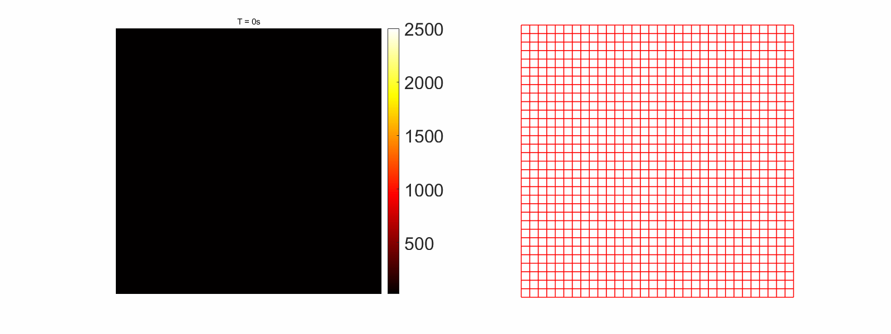
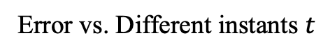
Introduction
Related work
Methodology
Results
Conclusions
Results
Solution and the corresponding parameterization
Error vs. Different instants $t$
Dalian University of Technology, Ye Ji
June 29, 2022
﻿Curvature-based $r$-Adaptive Parameterization for IGA 30/33
Notes:
The resulting anisotropic parameterizations of different time instants t are shown in the left figure. Again, the isoparametric lines concentrate the regions where the numerical solution with large variations. Finally, the relative total energy error at different time steps are shown in the right figure. Compared with the isotropic parameterization, the proposed method reduces the numerical error at all time steps.

Slide 31
Introduction
Related work
Methodology
Results
Conclusions
Catalogue
Introduction
Related work
Methodology
Experimental results and comparisons
Conclusions and future work
Dalian University of Technology, Ye Ji
June 29, 2022
﻿Curvature-based $r$-Adaptive Parameterization for IGA 31/33

Slide 32
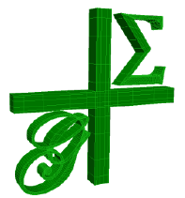
Introduction
Related work
Methodology
Results
Conclusions
Conclusions and future work
Conclusions:
An r-adaptivity based on absolute principal curvature is proposed for isogeometric analysis;
Bi-level approach using coarse and fine refinements is employed to balance efficiency and accuracy;
Bijectivity is guaranteed by regularization technique and common line search criteria;
Examples show the effectiveness, efficiency, and superiority of the proposed method.
Future work:
Extending the proposed method to shell and solid problems;
To further acceleration, combine our method with spline techniques with local refinement capability;
﻿We will release our reference implementation in Geometry + Simulation Modules (G+Smo) library.
Dalian University of Technology, Ye Ji
June 29, 2022
﻿Curvature-based $r$-Adaptive Parameterization for IGA 32/33
Notes:
In this work, we propose an r-adaptive parameterization technique for IGA based on the absolute curvature. Bi-level approach is employed for the sake of both efficiency and accuracy. Examples and comparisons show the effectiveness of the proposed method.
For the future work, extending the proposed method to the shell and solid problems is worthy of further investigation.
Second, to further acceleration, combining our method with spline tools with local refinement capability is a possible solution.
In addition, we will release all the models and our reference implementation in the gismo library!

Slide 33
Introduction
Related work
Methodology
Results
Conclusions
Thanks for your attention!
Q&A
jiye@mail.dlut.edu.cn
Dalian University of Technology, Ye Ji
June 29, 2022
﻿Curvature-based $r$-Adaptive Parameterization for IGA 33/33
Notes:
Thanks for your attention.

Slide 34
Introduction
Related work
Methodology
Results
Conclusions
Dalian University of Technology, Ye Ji
June 29, 2022
﻿Curvature-based r-Adaptive Parameterization for IGA 1/31

Slide 35
Introduction
Related work
Methodology
Results
Conclusions
Dalian University of Technology, Ye Ji
June 29, 2022
﻿Curvature-based r-Adaptive Parameterization for IGA 1/31

Slide 36
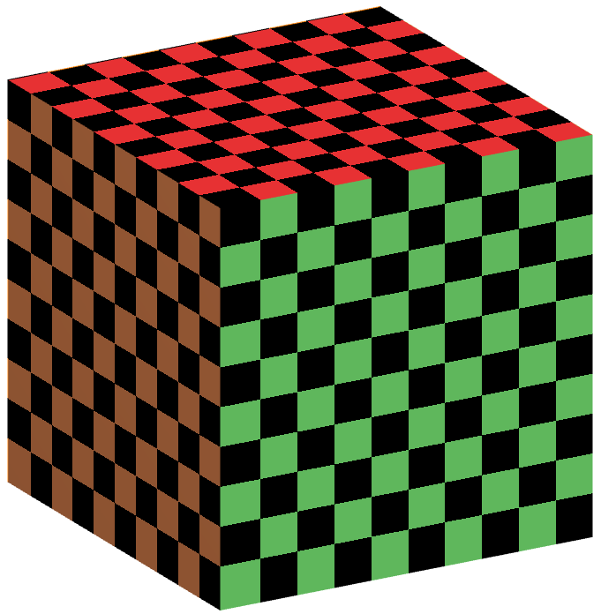
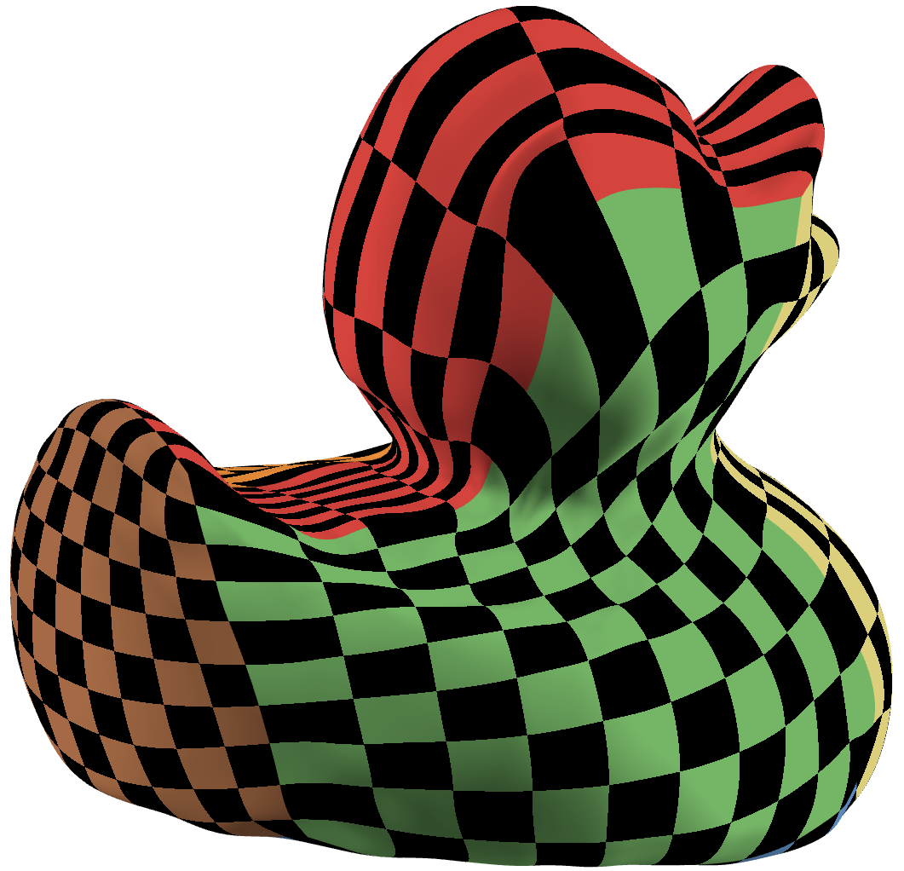
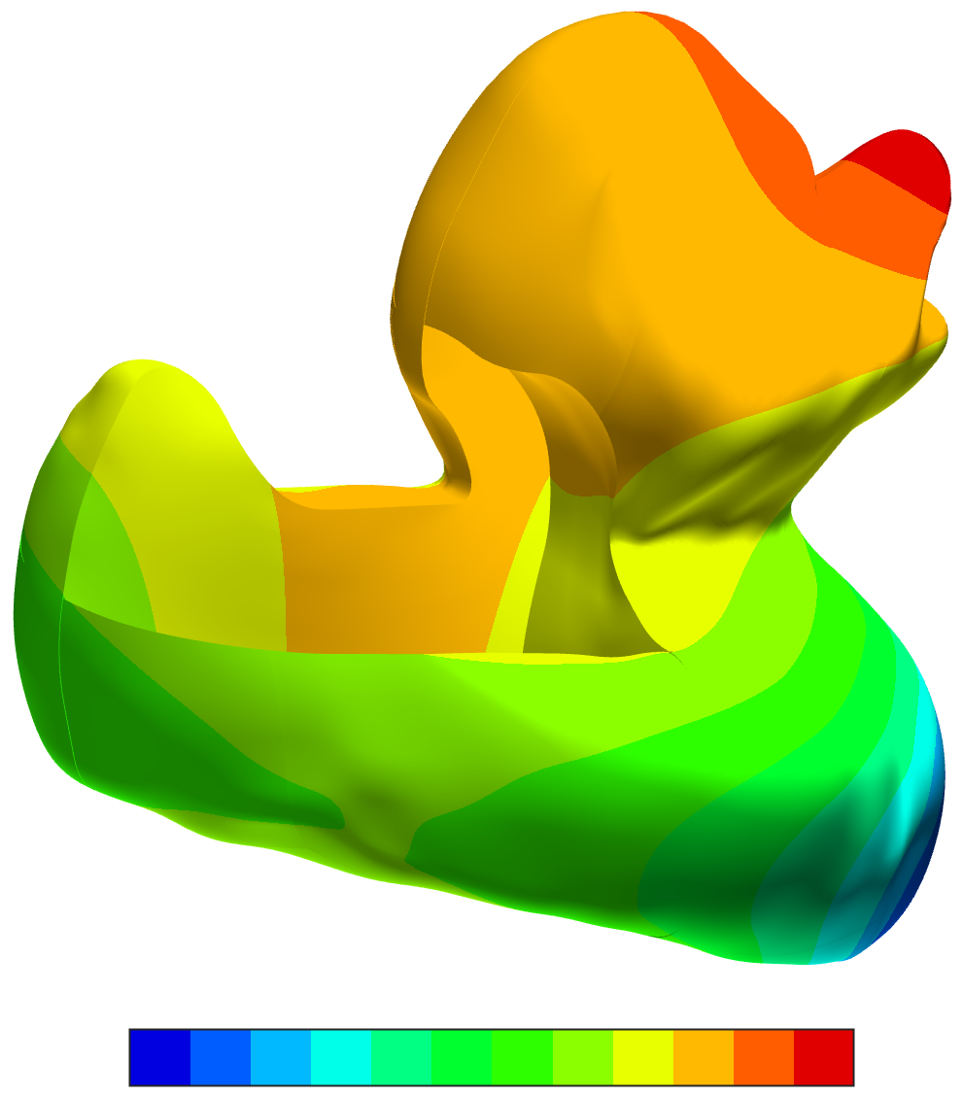
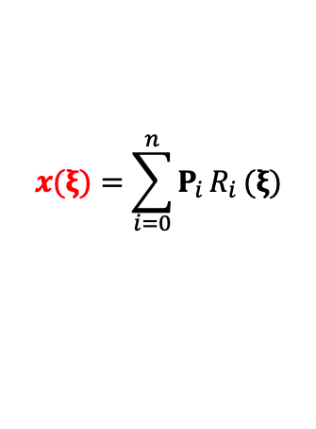
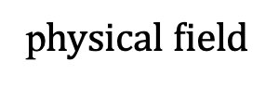
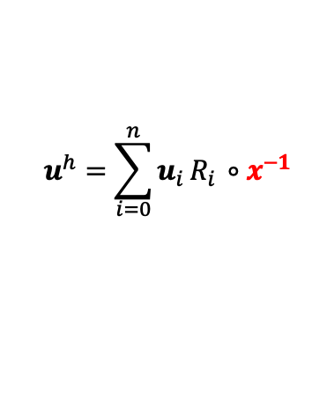
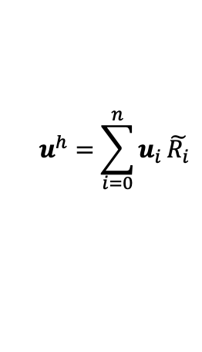
parametric domain
computational domain
$$x(ξ)=\sum_{i=0}^{n}{P_{i }R_{i }(ξ)}$$
$$u^{h}=\sum_{i=0}^{n}{u_{i }R_{i }∘x^{−1}}$$
$$u^{h}=\sum_{i=0}^{n}{u_{i }\tilde{R_{i}}}$$
p$hysical field$

